Slide 1
Enhancing DSC with Puppet
John O’Connor
Notes:
This is the slide shown before the presentation starts. When you are ready to go, tell the video operator to start the recording, and click to the next slide.
1

Slide 2
5
Video operator, did you start the recording?
YourTwitterHandle
Notes:
[REQUIRED SLIDE]
These slides are mandatory and help us with video post-processing. Please keep them as they are.
2

Slide 3
4
YourTwitterHandle
Notes:
[REQUIRED SLIDE]
3

Slide 4
3
YourTwitterHandle
Notes:
[REQUIRED SLIDE]
4

Slide 5
2
YourTwitterHandle
Notes:
[REQUIRED SLIDE]
5

Slide 6
1
YourTwitterHandle
Notes:
[REQUIRED SLIDE]
6

Slide 7
Enhancing DSC with Puppet
John O’Connor
Notes:
7

Slide 8


How would you order a Pizza?
Notes:
8

Slide 9
What the MENU Offers
Cheese & Tomato
Mozzarella cheese (tomato, cheese)
Vegetarian (tomato, onions, pepper, black olives)
Pepperoni (tomato, cheese and Spanish sausage)
Notes:
9

Slide 10
The Instructions for the Menu
EXECUTION
Put a thin layer of sauce on the dough.
Sprinkle some mozzarella cheese
Add a handful of onions
Add a handful of peppers
Add a few black olives
INSTRUCTIONS
I Want a Vegetarian Pizza
➔
Notes:
10

Slide 11
Procedural scripts for a pizza order
/******** Begin Procedure Script *********/
BEGIN
GOTO cupboard in the stockroom. GOTO third shelf from the bottom on left hand side facing the back.
can = Take the can of tomato sauce
open $can
sauce = pour ½ $can onto the pizza dough
END
/******** End Procedure Script *********/
Notes:
11

Slide 12
Instead – why not say what we want
pizza { “John’s order”:
sauce => tomato,
cheese => mozzarella,
vegetables => [onions,peppers,black olives],
meat => pepperoni
}
Easy for a person to write and understandable for a computer
Notes:
12

Slide 13
Consistency/Traceability across Organisation
Top Level Organisational declarations instead of obscure hard to manage procedures
Ability to manage diverse set of distributed services
Regulated environment needing traceability and auditing
The ever present “Need to do More with Less“
Notes:
13

Slide 14
This Session
What Puppet and DSC have in common
The Puppet value add to DSC
Case Study: Configure Windows Services Update Server (WSUS)
Notes:
14

Slide 15
DSC and Puppet - Similarities
Declaritive DSL (Domain Specific Language)
Used to enforce configuration.
Syntax and models are similar
Notes:
15

Slide 16
DSC .vs. Puppet DSC Lite
# DSC Example
File fruit_file {
Ensure = 'Present'
DestinationPath = 'C:\Fruit.txt'
Type = 'File'
Contents = 'Apple, Pear'
}
# Puppet DSC Lite Declaration
dsc {'fruit_file':
resource name => 'File',
module => 'PSDesiredStateConfiguration',
properties => {
ensure => 'Present',
destinationpath => 'C:\Fruit.txt',
type => 'File',
content => 'Apple, Pear'
}
}
Notes:
16

Slide 17
Puppet Value Add
Similar Syntax to DSC, so get up and running quickly
Manage large set of diverse nodes (Windows, Linux, Macos, Solaris, AIX, Cisco)
Alternative to Active Directory/GPO for Windows
Puppet has large library of existing resources, modules to aid capturing and managing your configuration.
Management tools/Common interface across platforms
Change tracking and auditing
Notes:
17

Slide 18





Puppet Architecture outline
Agent
User Interface
Puppet Master
Agent
Puppet User
Agent
Notes:
18

Slide 19
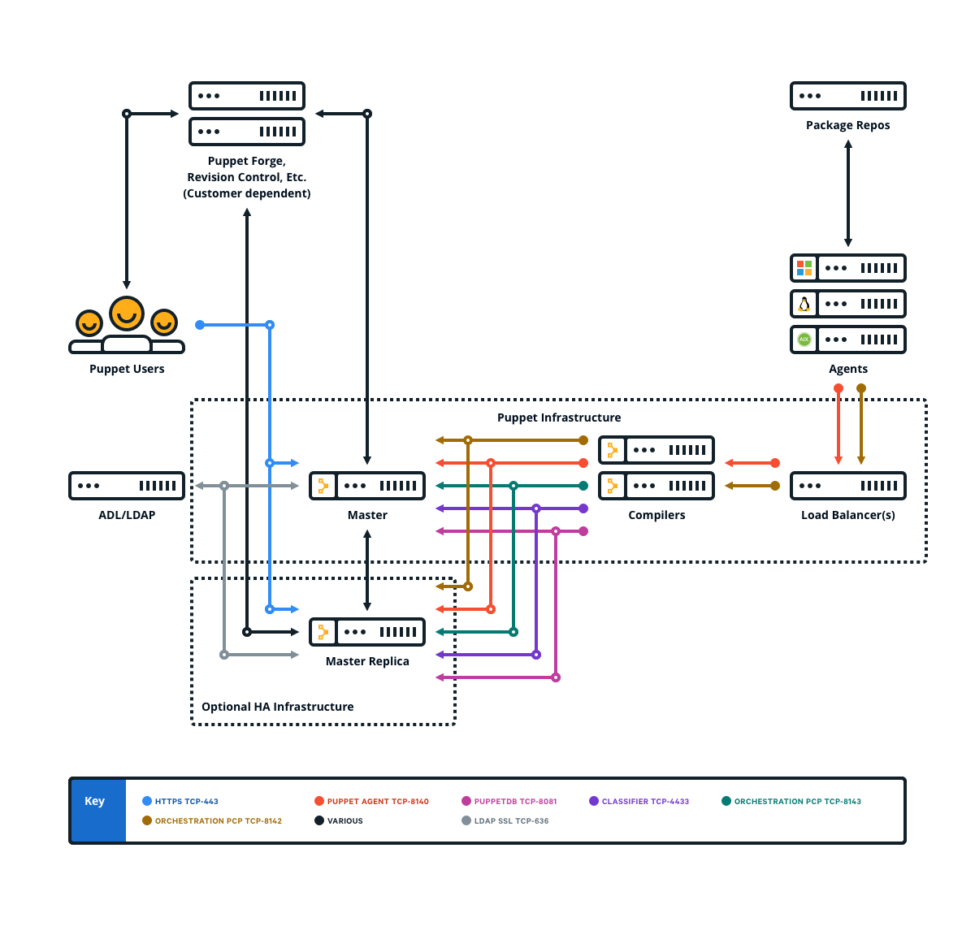
Extensible for large distributed system
4,000 ~ 20,000 nodes
Notes:
19

Slide 20
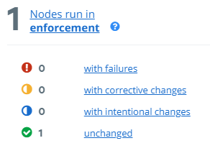
Reporting with Puppet and DSC
Change Reporting is a Must
Changes classified as
Failures
Corrective Changes
Intentional Changes
Unchanged
Notes:
20

Slide 21
Case Study – Configuring and monitoring change on Windows Services Update Server (WSUS)
Notes:
21

Slide 22

Tale of an unmanaged WSUS Server
Notes:
22

Slide 23
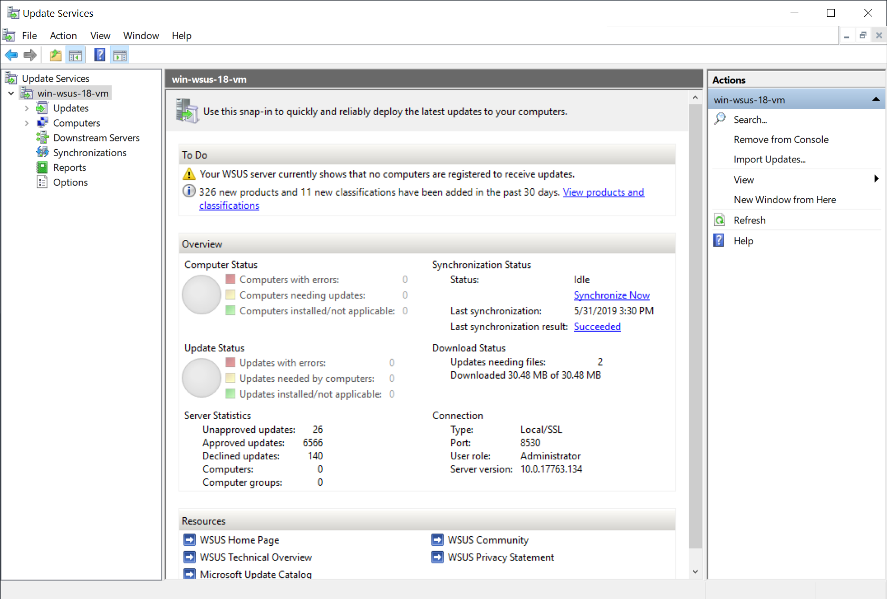
WSUS Console
Notes:
23

Slide 24
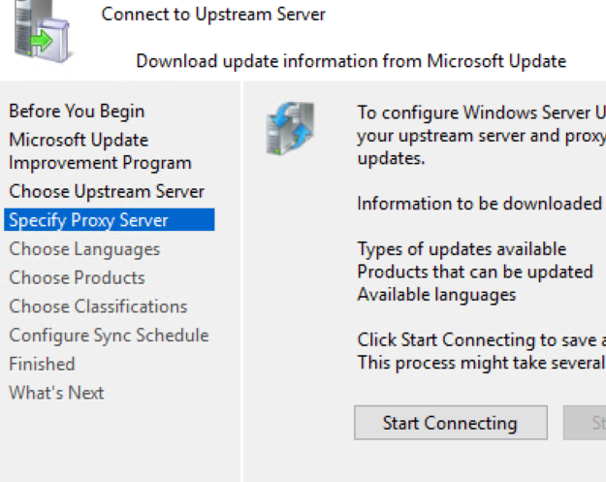
Manual WSUS Install/Configuration
Enable Features
“UpdateServices-Feature”
“UpdateServicesRSAT-Feature”
Run Configuration Wizard
Wait for WSUS to Synchronise
Notes:
24

Slide 25
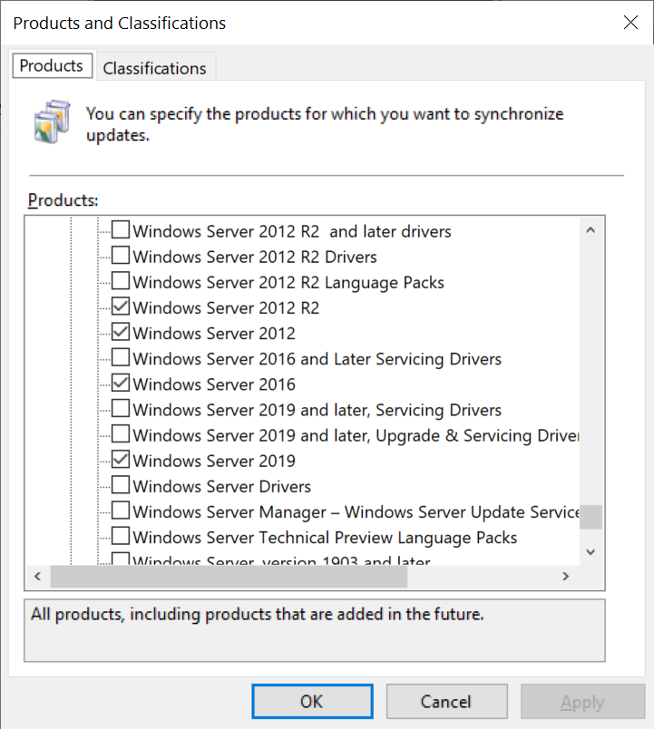
WSUS Products – Code .vs. Gui
products => [
'Windows 10 LTSB',
'Windows 10',
'Windows 7',
'Windows 8.1',
'Windows 8',
'Windows Server 2008 R2',
'Windows Server 2008',
'Windows Server 2012 R2',
'Windows Server 2012',
'Windows Server 2016',
'Windows Server 2019'
],
➔
Notes:
25

Slide 26
Demo Repository & DSC Module
github.com/jcoconnor/pscconfeu-dsc
Main File of Interest: site/profile/manifests/wsus/server/wsus_server.pp
Repo also includes some other examples of Puppet code used to configure the Demo Server with some useful Packages.
github.com/mgreenegit/UpdateServicesDsc
www.powershellgallery.com/packages/UpdateServicesDsc
Notes:
All the code for the demo is held on Github and I’ve included the repo and powershell gallery locations for the associated DSC Modules.
Repo also includes
Packages such as Notepad++
Some registry and GPO settings (e.g. disable the Server Management screen at login)
Sample Azure_ARM module used to create the Server Demo boxes
26

Slide 27
# The following GUIDS reference differing type of Updates
# for setting up WSUS and
# its associated approval rules.
$wsus_critical_updates = 'E6CF1350-C01B-414D-A61F-263D14D133B4'
$wsus_definition_updates = 'E0789628-CE08-4437-BE74-2495B842F43B'
$wsus_security_updates = '0FA1201D-4330-4FA8-8AE9-B877473B6441'
$wsus_service_packs = '68C5B0A3-D1A6-4553-AE49-01D3A7827828'
$wsus_update_rollups = '28BC880E-0592-4CBF-8F95-C79B17911D5F'
Dscfix::Lcm_config { 'disableLCM':
refresh_mode => 'Disabled'
}
Notes:
27

Slide 28
dsc {'UpdateServices-Feature':
resource_name => 'WindowsFeature',
module => 'PSDesiredStateConfiguration',
properties => {
ensure => 'present',
name => 'UpdateServices'
},
require => Dscfix::Lcm_config['disableLCM'],
}
Notes:
28

Slide 29
dsc {'UpdateServices':
resource_name => 'UpdateServicesServer',
module => 'UpdateServicesDsc',
properties => {
ensure => 'present',
contentdir => 'C:\WSUS',
languages => ['en'],
synchronize => true,
products => [ … ],
classifications => [ … ],
synchronizeautomatically => true,
synchronizeautomaticallytimeofday => '15:30:00',
},
require => Dsc['UpdateServices-Feature',
'UpdateServicesRSAT-Feature'],
}
Notes:
29

Slide 30
# Product List for ‘UpdateServices’
products => [
'Windows 10 LTSB',
'Windows 10',
'Windows 7',
'Windows 8.1',
'Windows 8',
'Windows Server 2008 R2',
'Windows Server 2008',
'Windows Server 2012 R2',
'Windows Server 2012',
'Windows Server 2016',
'Windows Server 2019'
],
Notes:
30

Slide 31
# Classification List for ‘UpdateServices’
# and ‘CleanupRules’
classifications => [
$wsus_critical_updates,
$wsus_definition_updates,
$wsus_security_updates,
$wsus_service_packs,
$wsus_update_rollups,
],
Notes:
31

Slide 32
dsc {'UpdateServicesCleanup':
resource_name => 'UpdateServicesCleanup',
module => 'UpdateServicesDsc',
properties => {
ensure => 'present',
declineexpiredupdates => true,
declinesupersededupdates => true,
cleanupobsoleteupdates => true,
cleanupunneededcontentfiles => true,
},
require => Dsc['UpdateServices'],
}
Notes:
32

Slide 33
dsc { 'ApprovalRules':
resource_name => 'UpdateServicesApprovalRule',
module => 'UpdateServicesDsc',
properties => {
ensure => 'present',
name => 'Definition Updates, … ………',
enabled => true,
synchronize => true,
runrulenow => true,
classifications => [ … ],
},
require => Dsc['UpdateServices'],
}
Notes:
33

Slide 34
Demo (1) – Configuring WSUS on Server
Agent
User Interface
Puppet Master
Agent
Puppet User
Agent
Notes:
34

Slide 35
Demo (2) – Correcting/Reporting a change
Agent
User Interface
Puppet Master
Agent
Puppet User
Agent
Notes:
35

Slide 36
DSC and Puppet: best of both worlds
Doing more with less.
Infrastructure as code that all teams can use.
Apply your PowerShell DSC skills with Puppet.
Get going quickly with Puppet
Notes:
36

Slide 37
Notes:
37

Slide 38
Resources (1) – Demo and DSC Repos
github.com/jcoconnor/pscconfeu-dsc
Main File of Interest: site/profile/manifests/wsus/server/wsus_server.pp
Repo also includes some other examples of Puppet code used to configure the Demo Server with some useful Packages.
github.com/mgreenegit/UpdateServicesDsc
www.powershellgallery.com/packages/UpdateServicesDsc
Notes:
38

Slide 39


Resources (2) – Puppet DSC Modules
forge.puppet.com/puppetlabs/dsc_lite
forge.puppet.com/puppetlabs/dsc
Notes:
39

Slide 40
Resources (3) – Puppet/DSC Blogs
https://puppet.com/blog/managing-powershell-dsc-puppet
https://puppet.com/blog/dsc-deep-dive-get-up-and-running-dsc-module
https://puppet.com/blog/dsc-deep-dive-installing-and-configuring-iis-using-puppet-and-powershell-dsc
https://puppet.com/blog/james-pogran-on-learning-powershell-dsc
https://puppet.com/blog/introducing-dsclite-new-dsc-module-puppet
Notes:
40

Slide 41




Resources (4) - Puppet
puppet.com/products
Notes:
https://puppet.com/products/puppet-enterprise
https://puppet.com/blog/litmus-new-module-acceptance-testing-tool
https://github.com/lyraproj/lyra
https://puppet.com/products/puppet-remediate
https://github.com/puppetlabs/bolt
https://puppet.com/blog/2019-state-devops-survey-here
41

Slide 42
Acknowledgements
James Pogran for the original DSC and Puppet Talk
www.youtube.com/watch?v=dR8VJjDmo9c
speakerdeck.com/jpogran/using-puppet-and-dsc-to-report-on-environment-change
Alberta Bosco for the pizza example
Photo by Ben White on Unleash for “Tale of Unmanaged Server”
unsplash.com/photos/qDY9ahp0Mto/info
Notes:
42

Slide 43
Who am I
With Puppet for 4 years
Release Engineering
Puppet Agent and Platform Support
Automation of Golden Images
Windows Team
Previous – variety of System Admin, Software engineering roles across Education, Financial, Telecoms and Security sectors.
Classical Music and Opera enthusiast, Walking
Managing PA and AV for my local church
jcoconnor
Notes:
43

